Slide 1
Fundamentals and Methods of Computer Science
Exercise week 5

Slide 2
Today’s Menu
Discussion of assignment 4 and the respective quiz
More details about this semester’s group project
Brief summary of skills necessary to solve assignment 5
Working on assignment 5

Slide 3
Discussion of assignment 4 and the respective quiz

Slide 4
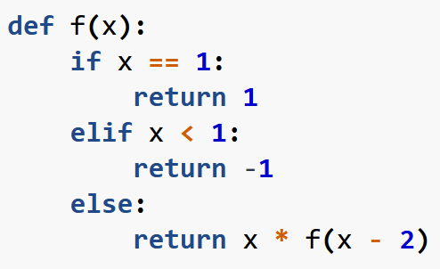
Assignment 4 & Quiz 4: What the questions were about
# a recursive function calls itself
def fib(n):
# don’t forget the base condition(s)
if n == 0:
return 0
# don’t forget the base condition(s)
elif n == 1:
return 1
else:
return fib(n - 2) + fib(n - 1)
recursion
map()
iterable methods: sorted & reversed
A „complicated“ line of code
print(‘Hello World’)
Hello World
print(‘Hello’, ‘World’)
Hello World
x = 5
y = 6
print(x + y)
11
print(‘The result of x + y is’, x + y)
→ The result of x + y is 11

Slide 5
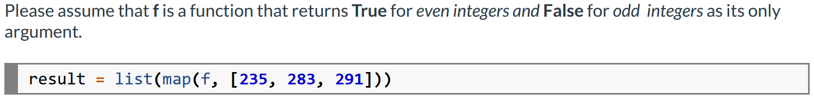
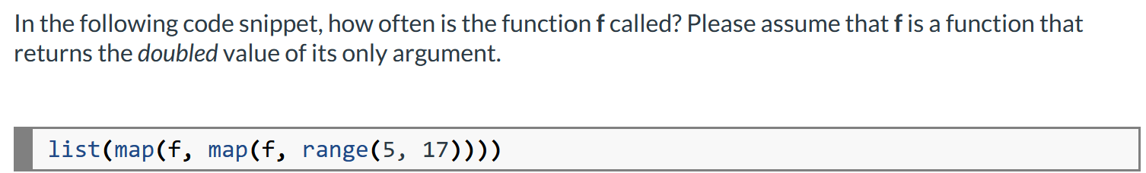
Assignment 4 & Quiz 4: What the questions were about
# define a function (alternatively you could
# use a lambda function) that returns a value
def sort_numbers_by_digit(number):
return "".join(sorted(str(number),
reverse=True))
# map() applies the function for each value
# in the iterable and returns an iterator,
# which can be used in loop or typecasted
a= list(map(sort_numbers_by_digit, a_list))
recursion
map()
iterable methods: sorted & reversed
a „complicated“ line of code
print(‘Hello World’)
Hello World
print(‘Hello’, ‘World’)
Hello World
x = 5
y = 6
print(x + y)
11
print(‘The result of x + y is’, x + y)
→ The result of x + y is 11

Slide 6
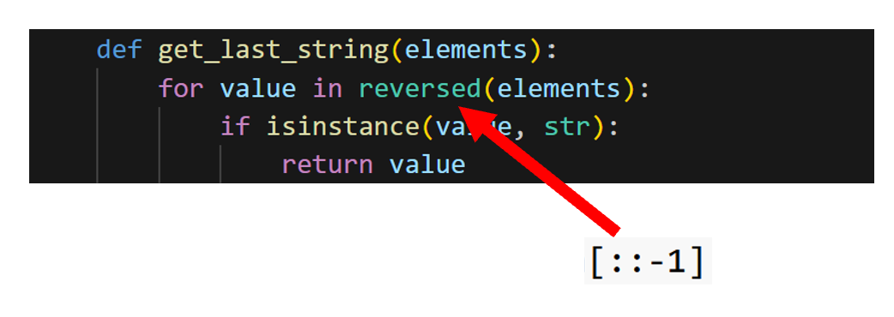
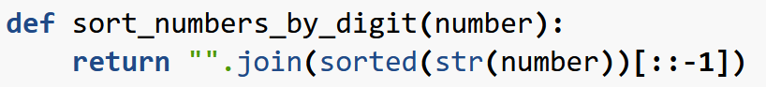
Assignment 4 & Quiz 4: What the questions were about
Remember last week’s quiz question:
recursion
map()
iterable methods: sorted & reversed
a „complicated“ line of code
print(‘Hello World’)
Hello World
print(‘Hello’, ‘World’)
Hello World
x = 5
y = 6
print(x + y)
11
print(‘The result of x + y is’, x + y)
→ The result of x + y is 11

Slide 7
Assignment 4 & Quiz 4: What the questions were about
# Start by making sense of the innermost filter function → We have a test for equivalence ==
# Let’s start with the list comprehension
The (lazily evaluated) list will contain the squared value of those items in range(yyy) that fulfil the function XXX.
# And on the left side:
By using filter, we are left with an iterable that contains all those items in range(yyy) that fulfil the function XXX. Then we map our square function to those and convert to a list. Thus, they’re equal.
recursion
map()
iterable methods: sorted & reversed
a „complicated“ line of code
print(‘Hello World’)
Hello World
print(‘Hello’, ‘World’)
Hello World
x = 5
y = 6
print(x + y)
11
print(‘The result of x + y is’, x + y)
→ The result of x + y is 11

Slide 8
Group project: Introduction

Slide 9



Introduction to Group Project
Group Project
IDEA
DELIVERABLES
WHAT IS GRADED?
14.12.23 23:59
Groups (10 / 11 people within the same exercise group) build a small web app using streamlit.
Max. 5 min. Video
&
Documented App Source code
Also:
- Presentation of video &
5 min. Q&A (15.12.)
- Top-3 present (20.12)
Mandatory Requirements (see * on the details slide)
Extended Requirements
No better grade; can influence
}
Yes
Fulfilled?
How well?
Grade
No

Slide 10
Deliverables
Details
5-minute (max.) video on your project idea, process, contributions and result including a short demo of your application.
The working and well documented source code of your application (we need to be able to run your application).
Both deliverables need to be uploaded by Thursday, 14.12.2023, 23:59 to Canvas.
Each group will show their video in their exercise group on Friday, 15.12.2023 and will have a 5-minute Q&A session afterwards (mandatory).
The selected top-3 groups will present their solution in the lecture session on Wednesday, 20.12.2023 (mandatory).
Be careful to reference everything, that is not yours (e.g., other people’s contributions, source code, etc.). See exercise session for details.

Slide 11
What is graded?
Details
* Requirements relevant for evaluation/grading (mandatory)
A problem that is solved by the application is clearly stated (e.g., business or consumer use case)
The application uses some data that is loaded via some API and/or provided via some database
The application visualizes some data that serves the use case
The application allows for some user interaction, e.g., adding additional data, selecting certain data, running certain data analyses
The source code is well documented by comments in the source code
The contributions of each team member are documented (e.g., contribution matrix).
The result is presented and demoed in a 5-minute video
Extensions not relevant for evaluation but for the “beauty” of the result (optional)
The application implements some machine learning
The application is made publicly available to users, e.g., via the streamlit platform
… anything you ever wanted to implement

Slide 12
Milestones / When is attendance mandatory*?
Group Project
Self assignment is possible from Friday, 20.10.2023, 12:00 noon till Thursday, 26.10.2023, 23.59 midnight.
Week 06 - exercise: Group definition / assignment, Q&A for project
BREAK
Week 07 - exercise: Presentation of project idea / approach → Feedback (max. 10 minutes/group)** (You)
Week 08
Week 09 - exercise: Presentation of MVP (first version of results) → Feedback (max. 10 minutes/group)** (You)
Week 10
Week 11 - exercise: Upload of solution (14.12), Presentation of Video, 5 minutes Q&A session/group (You)
Week 12 - lecture: Presentation of Top-3 groups (You)
*) You should attend the exercise session. If you can’t make it, you have to discuss this with
your group and your exercise session tutor.
**) The 10-minute slot is for presentation and feedback. This is not a lot of time, you decide on how much you will present, i.e., how much time there will be for feedback.

Slide 13

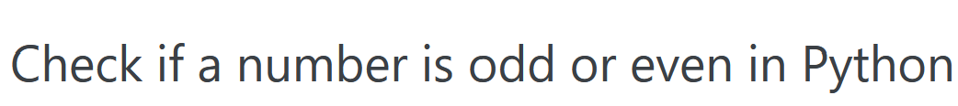
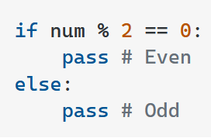

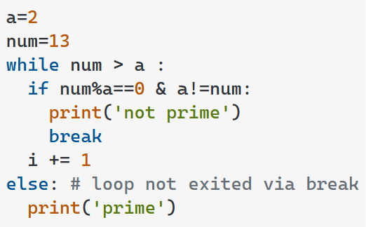
Plagiarism in Coding
Group Project
Copying or adapting someone else’s work (incl. code) with proper attribution and not presenting it as one's own original work.
Acceptable
Examples
Docs, Google, Stack Overflow, …:
Using resources to learn about a specific function
→ No citation needed
Using small snippets to solve a specific
problem or learn a method
→ No citation needed
Using large snippets to solve a specific task
Cite source
Friends, Tutors, Fiverr, …:
Asking questions → no citation needed *
ChatGPT, …:
Asking questions → no citation needed *
Writing code for you → Cite source *
Careful here!
«Do you know how I can check if a number is prime?»
«How can I check if a number is prime?»
«Write Python code to check if a number is prime»
*) see next slide

Slide 14

Plagiarism in Coding
Group Project
Copying or adapting someone else’s work (incl. code) without proper attribution and presenting it as one's own original work.
Unacceptable
Examples
Docs, Google, Stack Overflow, …:
Using large snippets to solve a specific task without citation
Using large code snippets / whole programs without permission & citation
Friends, Tutors, Fiverr, …:
Writing code for you
ChatGPT, …:
Writing code for you without citation
This is a joke about programmers commenting everything in their code.
I used this image without asking for permission, neither giving a citation
→ Not allowed in your work!
«Can you write that code for me?» / «Can you dictate me exactly what code I should write?»
«Write Python code to check if a number is prime»
* Follow the university guidelines and write a directory of aids when making use of other peoples’ help or generative AI. Everything else is considered plagiarism!

Slide 15
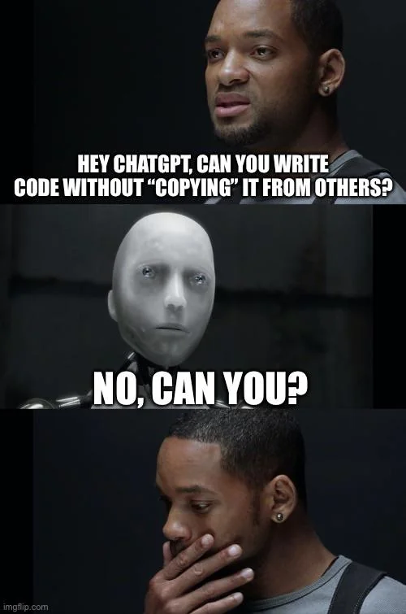
A note on ChatGPT
Group Project
If you let ChatGPT code your whole program & cite this appropriately, this is …
… fine from a plagiarism point of view.
… bad from a contributional point of view.
In programming you as a programmer …
… don’t need to reinvent the wheel
… need to put the code together in a new way, such that it solves your specific problem
→ If your solution lacks contribution, it won’t be good for your grade, even if the code is perfect.

Slide 16



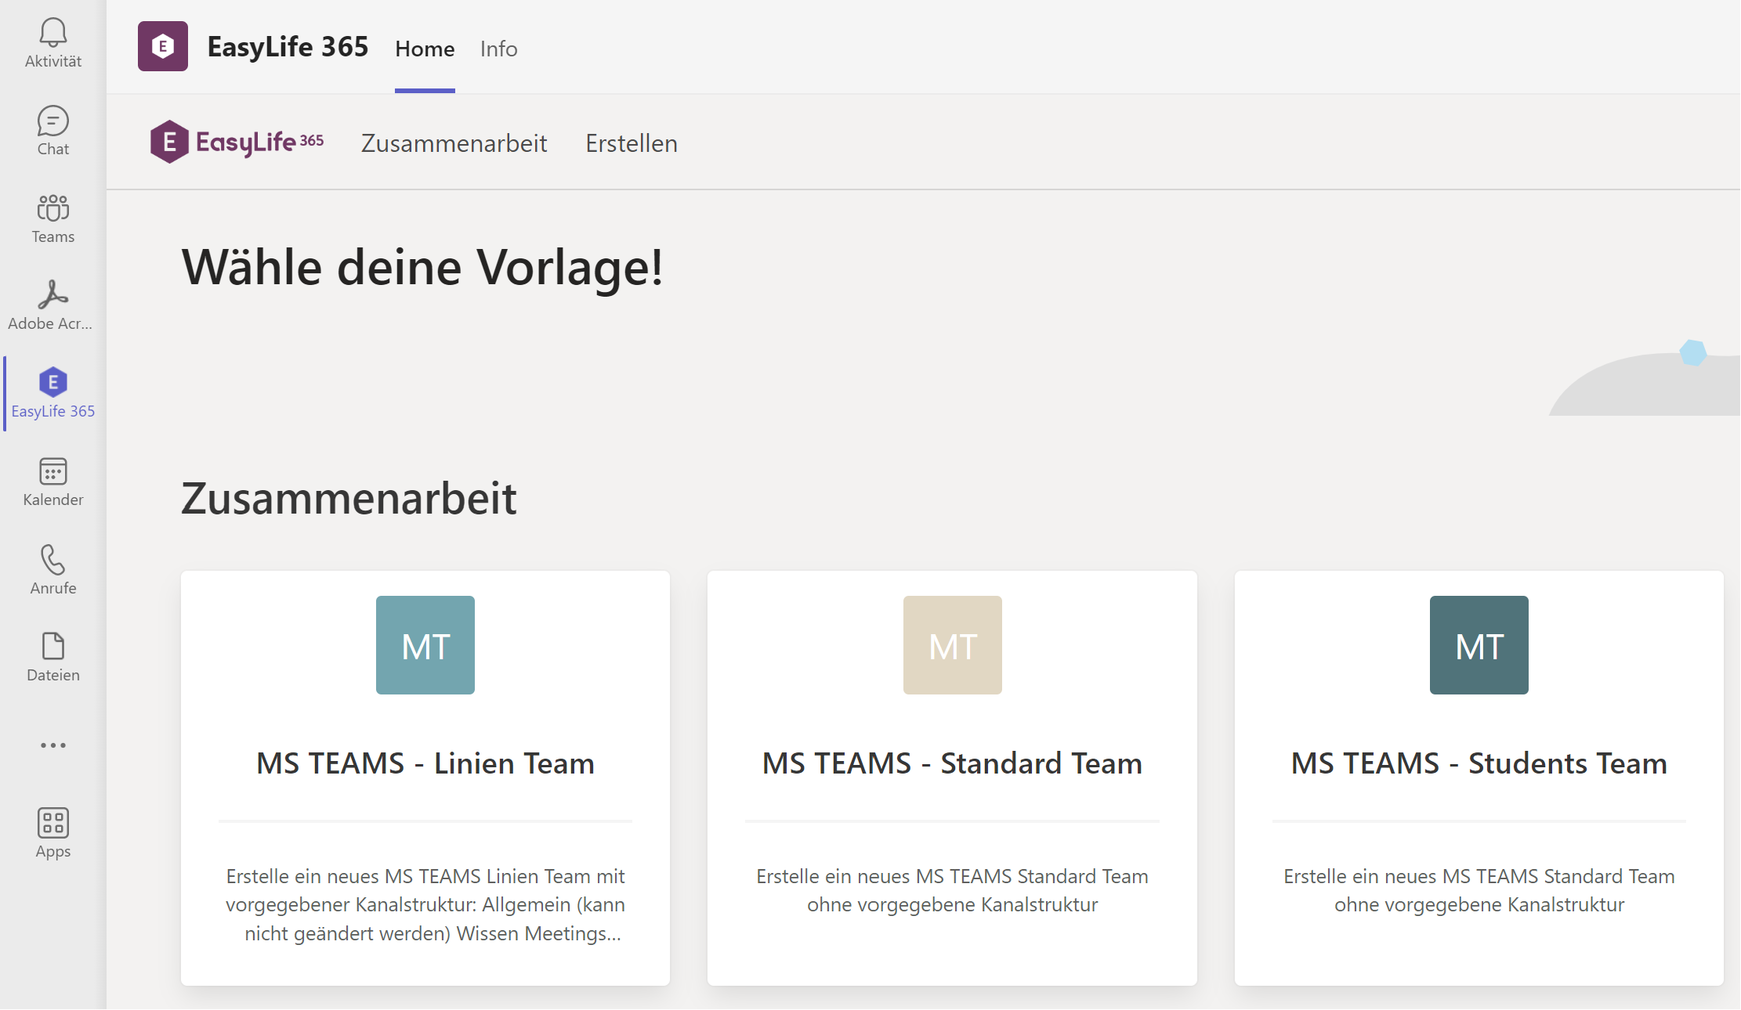
Collaboration and communication
Group Project
Escalate unsolvable conflicts to your tutor early.
Primer
next week

Slide 17
Group project: After this exercise you should know the things on Slides 18-23

Slide 18
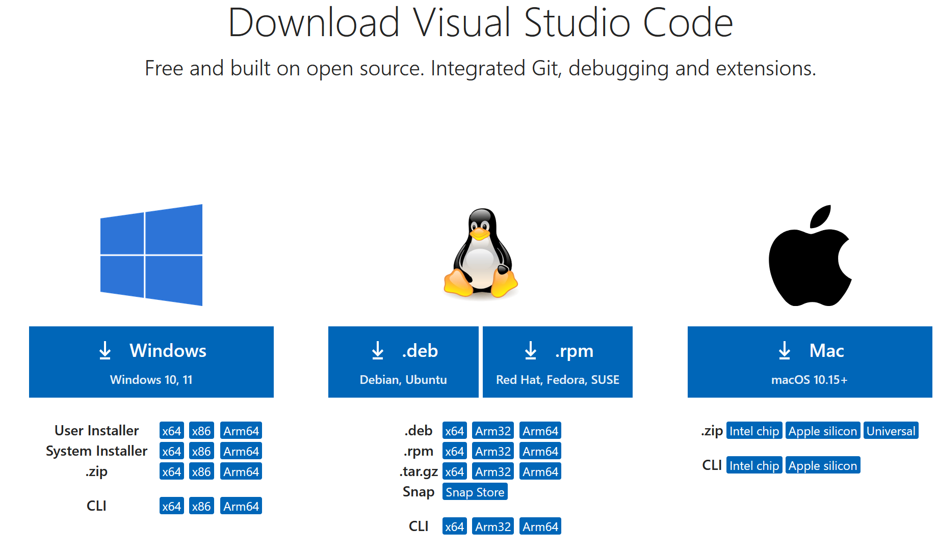
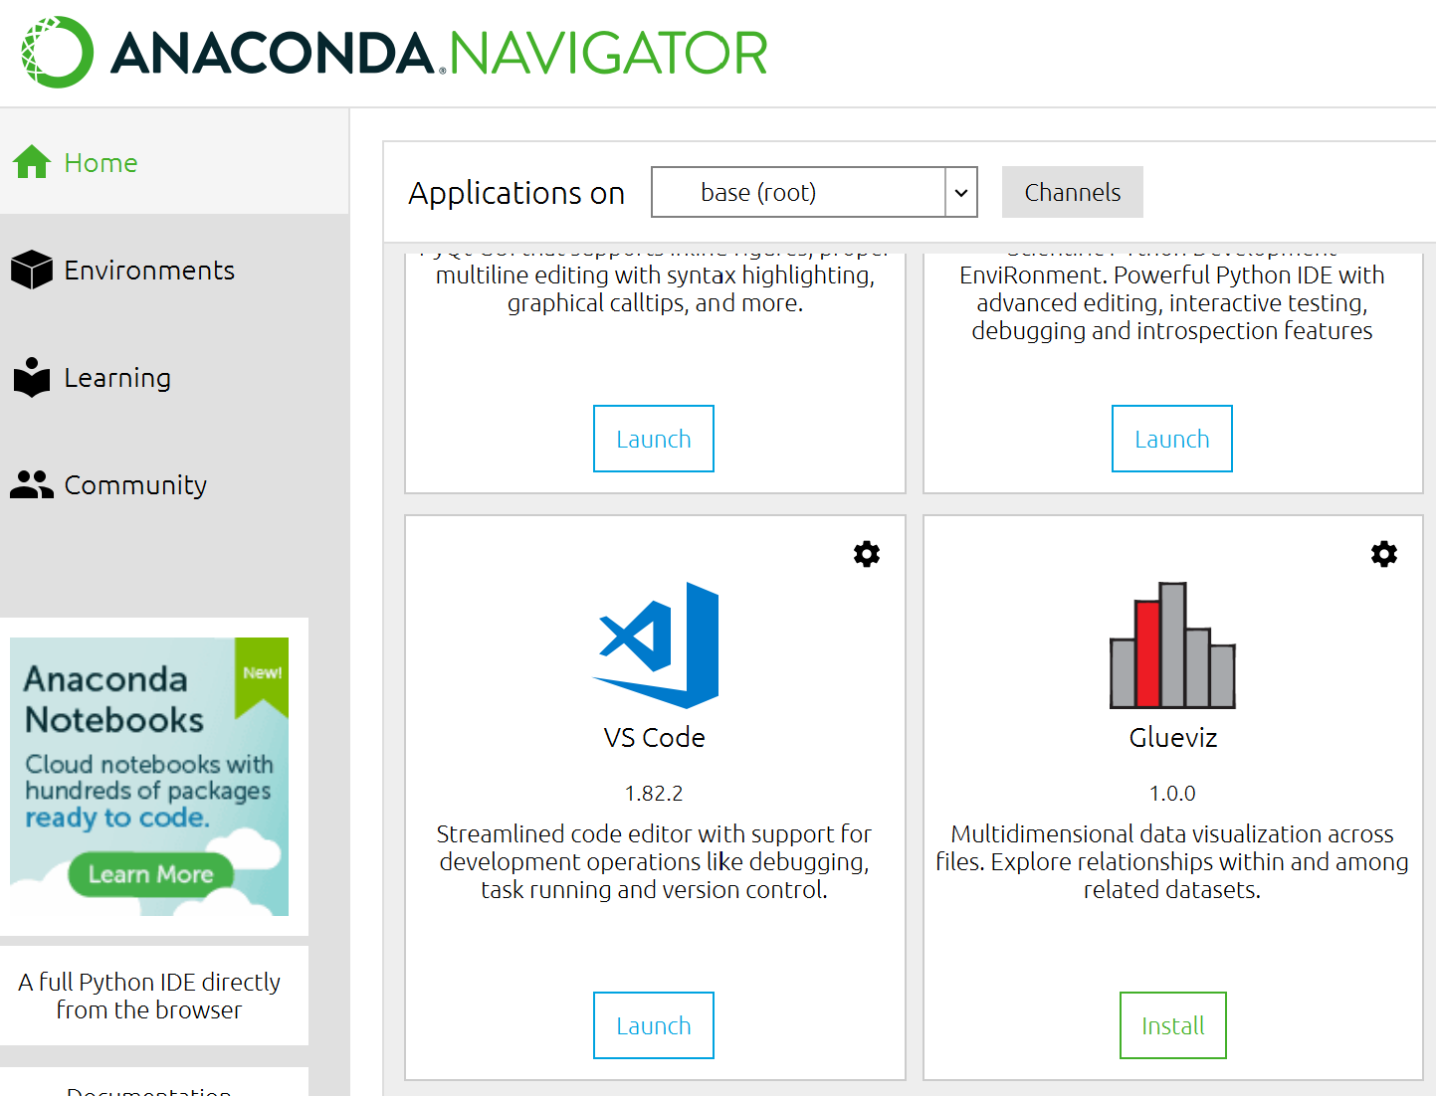
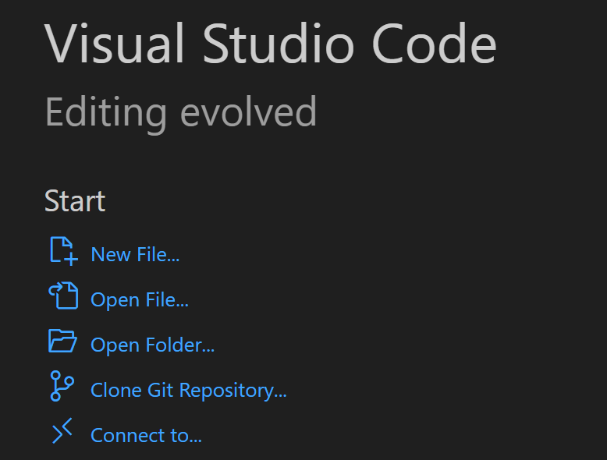
Streamlit – step-by-step
GOAL) You can:
open the text editor
of your choice!
1
Install a text editor (or IDE)

Slide 19
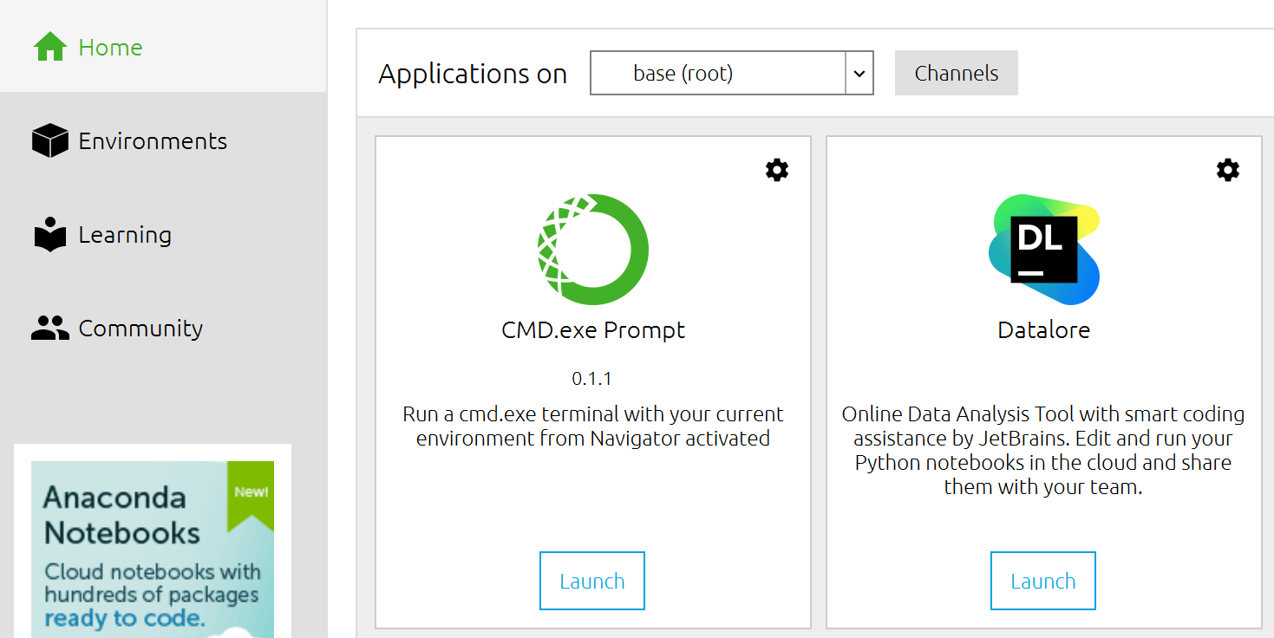
Streamlit – step-by-step
GOAL) You can:
1) open the CMD
2) use «pip install …»!
Mac: Use the normal terminal
Win: Use the Anaconda CMD
(normal CMD possible, but we will not support further)
2
Open Anaconda commandline
Install streamlit:
pip install streamlit
Note all your installed packages in a file called: requirements.txt e.g.
streamlit

Slide 20
Streamlit – step-by-step
GOAL) You can:
1) navigate in CMD
2) run «streamlit hello»
3) run a .py file with streamlit
3
Try streamlit example
When asked for email, just hit "enter" → should open in Browser!
Stop execution of a Python program with CTRL+C.
Overview of current folder with dir (Mac: use ls)
Navigate to subfolder with cd subfolderName (start typing & hit TAB)
Navigate one folder up with cd ..
Repeat last command with UP / DOWN
Navigate to the lecture example and execute it with streamlit run …
Navigate to the lecture examples and try those
Note: You could also execute it with full path (starting from current location)

Slide 21
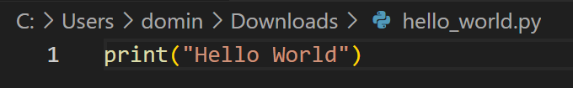
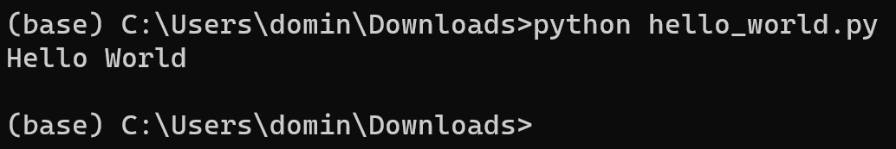
Streamlit – step-by-step
GOAL) You can:
1) create your own .py file
2) run your own .py file in CMD
4
Open your text editor
Store your text file with the .py extension
Depending on your system, you might need to use python3
Try a basic «Hello World» file

Slide 22
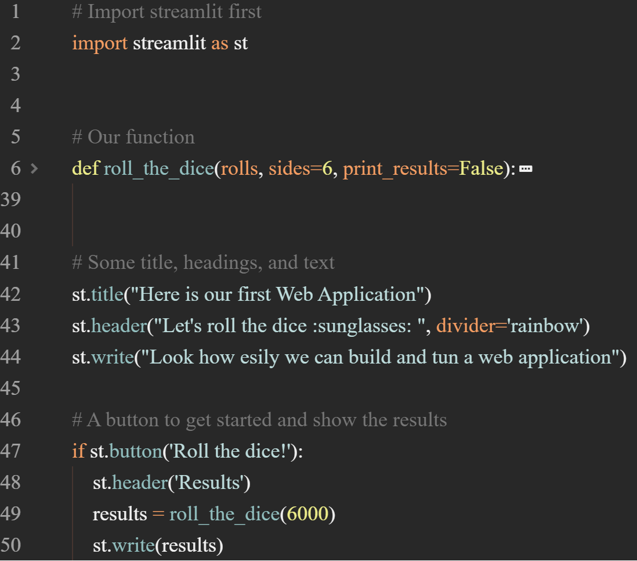
Streamlit – step-by-step
Your task now)
1) Learn how streamlit works
2) create own streamlit .py file
3) run own .py with streamlit
5
Play around with streamlit
Example App: https://fcs-intro.streamlit.app/
Corresponding Code: https://github.com/hawk-li/fcs-streamlit-intro/blob/main/app.py
Bonus Example: https://github.com/hawk-li/fcs-streamlit-auto-doc-ipynb/tree/main

Slide 23
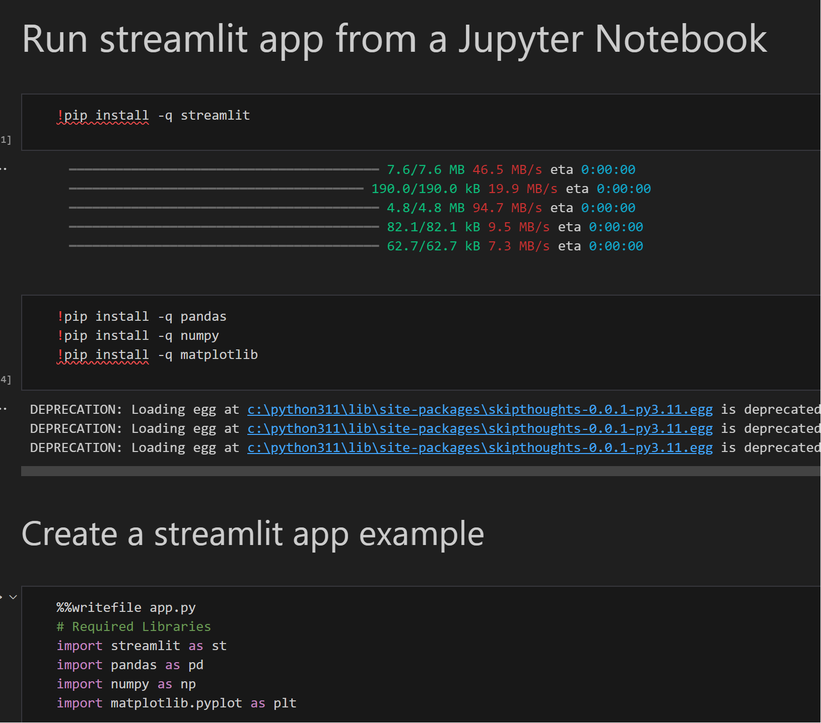
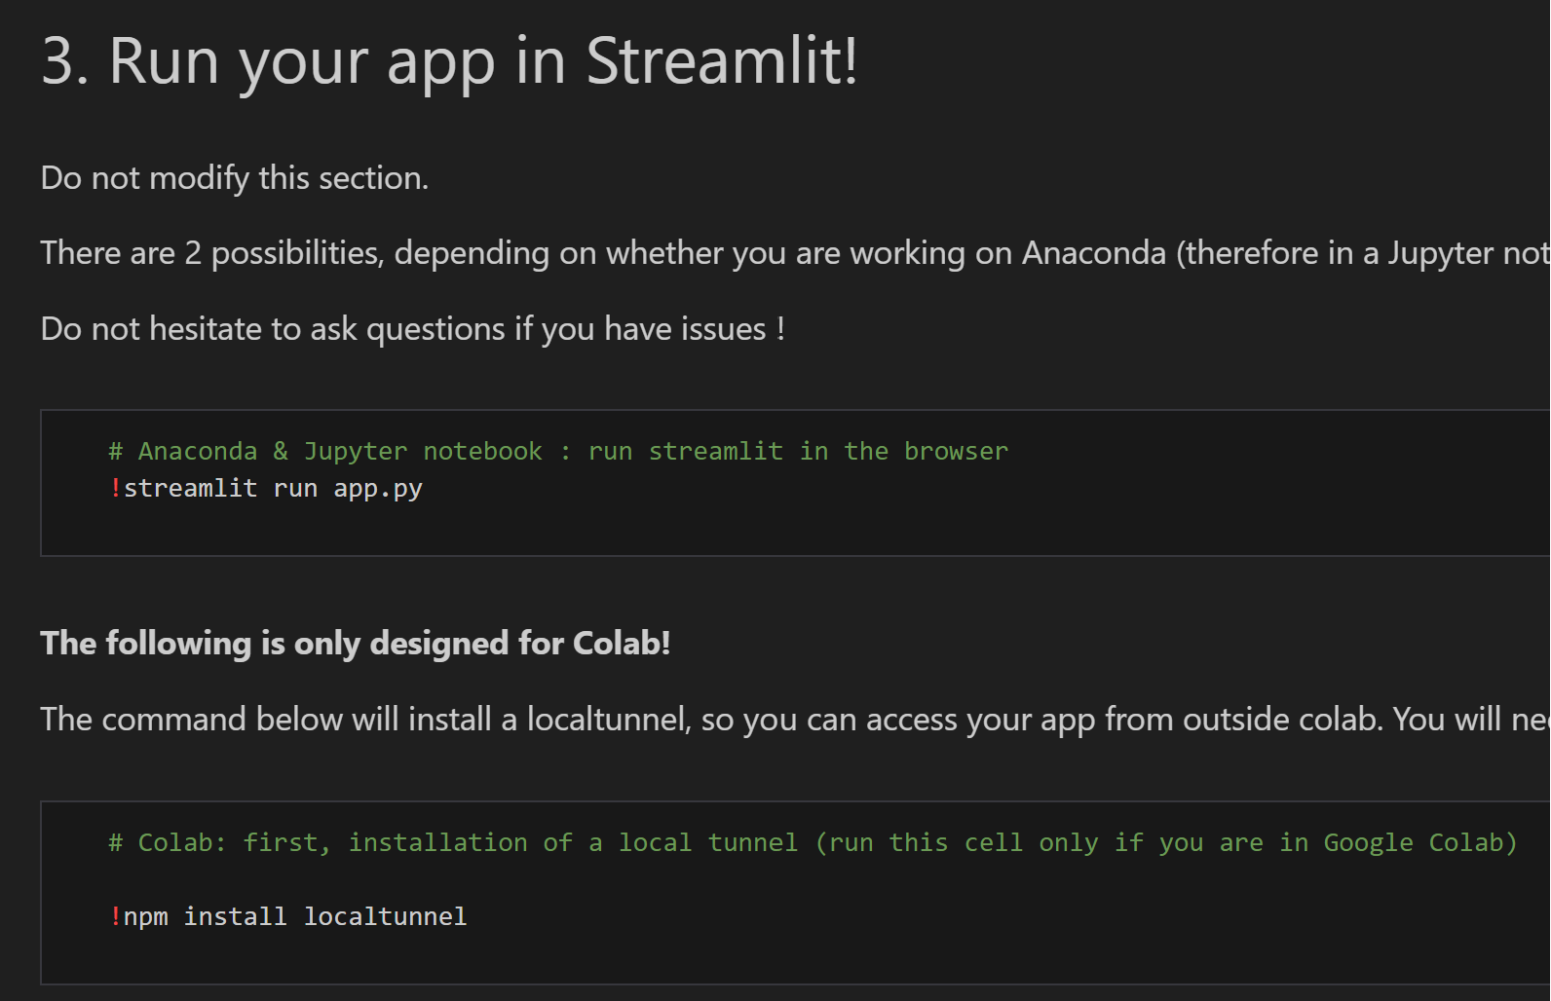
Streamlit – Note
Also: Don’t worry too much about virtual environments (conda create / conda activate), you can code in the main env. To hand in the project we will revisit this topic and help you to create your requirements.txt file.
You have seen last week, that it is possible to code, store & execute a streamlit app from a Jupyter Notebook.
After today, you should understand, that these notebooks did just use special syntax (! to execute code in CMD),
to do the same things that you can do yourself: use pip install, store .py files & execute streamlit run in CMD.
→ Jupyter allowed you a fast start, but for the actual group project, we recommend to run the commands yourself.

Slide 24
Brief summary of skills necessary to solve assignment 5

Slide 25
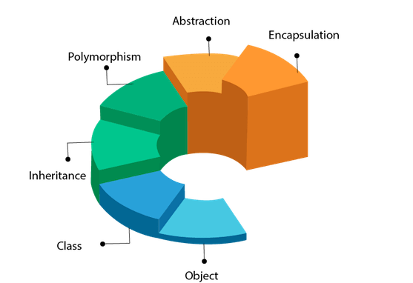
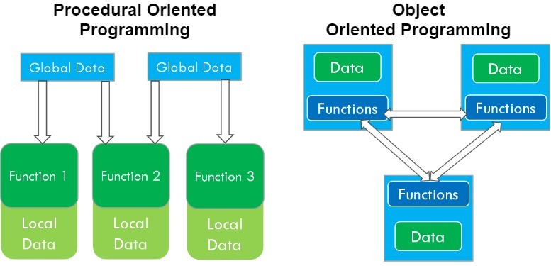
Object Oriented Programming: The Basics (1/2)

Slide 26
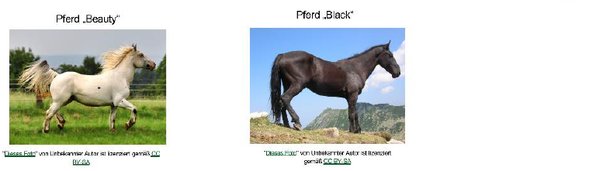
Object Oriented Programming: The Basics (2/2)
everything is an object
class horse
methods e.g. jump() or
walk(2)
Abilities
jump
walk
Attributes
Height
Speed
attributes
with attribute
values
methods
attributes
Objects are instances of classes (blueprint) with attribute values
Methods are executed on objects
Sub classes inherit attributes & methods from super (base) classes
Any time an object is created it is instantiated.

Slide 27
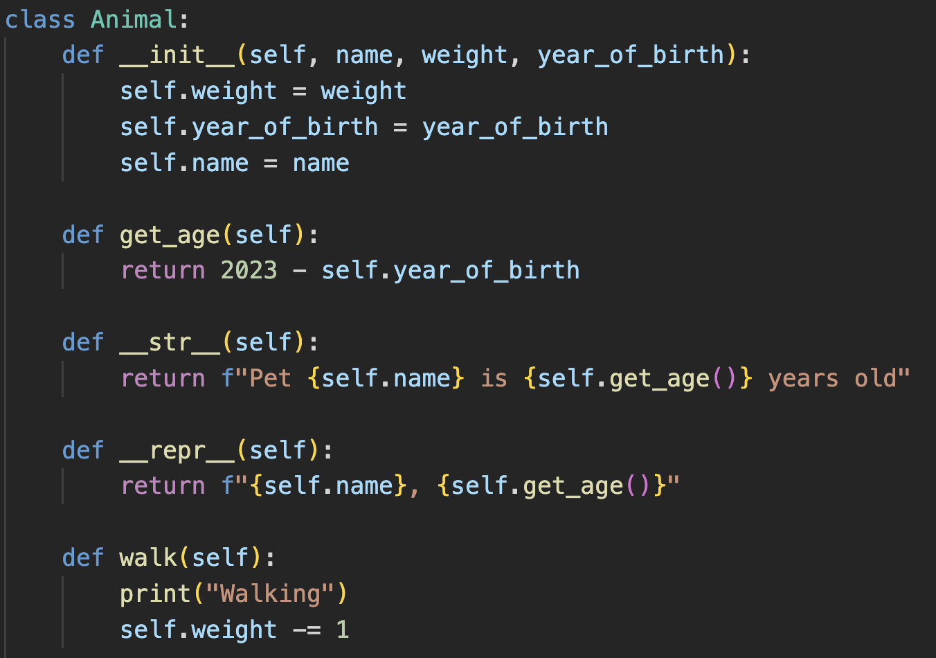
Class – a new datatype
In object-oriented programming, a class is an extensible program-code-template for creating objects, providing initial values for state (member variables) and implementations of behavior (methods)
# to create a class, we use the following syntax
class MyClass:
# __init__ is called when a new object is # instantiated - constructor
def __init__(self, p1, p2): # assign values to object attributes
self.p1 = p1
self.p2 = p2
# self is used for object specific (not static) methods
def my_method(self):
print("Hello")
# to access an attribute within a class, we use the # the keyword self
def get_p1(self):
return self.p1

Slide 28
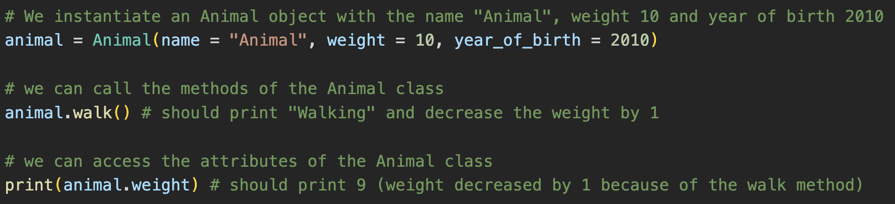
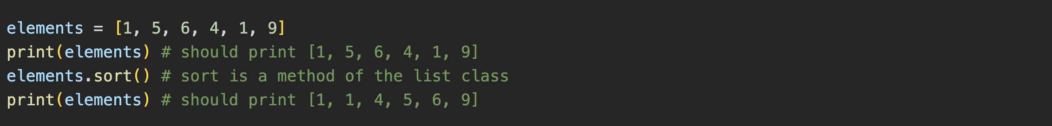
Objects are Instances of a Class
Objects instantiate Classes Objects have attribute values
Methods can be executed on objects. Methods may affect attribute values
Built in data types (classes) have methods you already know and have used

Slide 29
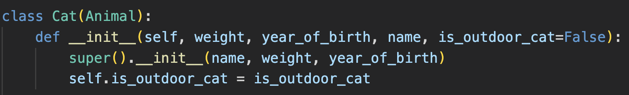
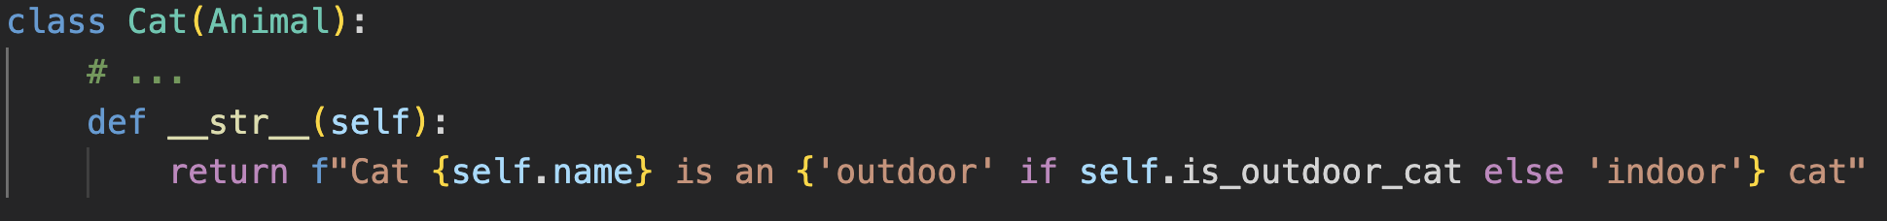
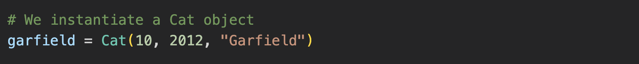
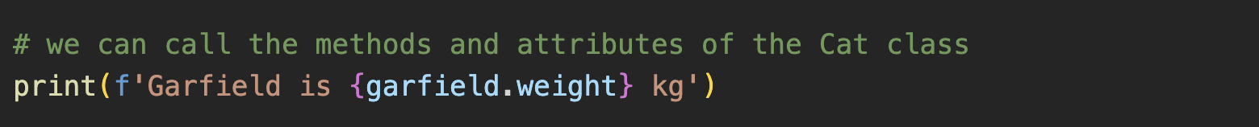
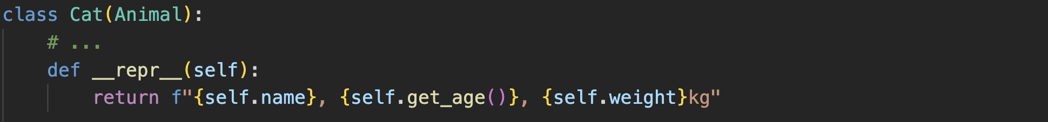
Special Methods
__init__
__str__ / __repr__
1) Define __init__ method in class
The __str__ method should return a human readable string representation of the object
> “H”
> “!”
2) When a new object is instantiated __init__ is called (constructor method)
> “!”
When you want to print an object, the __str__ method is called
> “H”
> “Hello”
> “World!”
2) After instantiation, attributes and methods of the object can be called
The __repr__ method on the other hand is used to return an internal string representation of the object

Slide 30
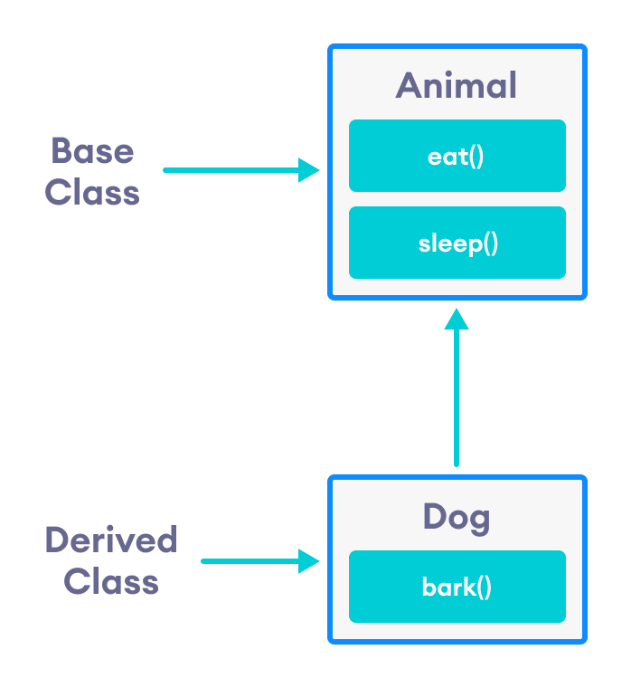
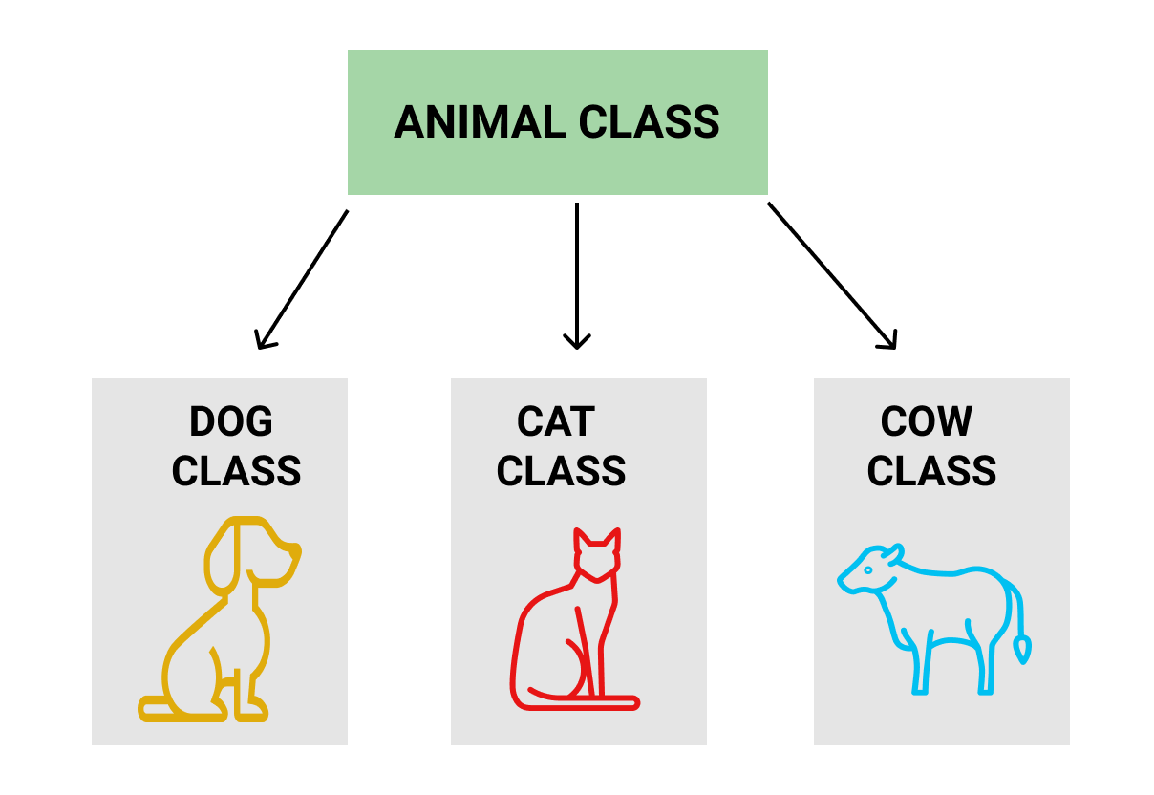
Inheritance (1/2)
Sub classes inherit attributes from super class(es)
Sub classes inherit methods from super class(es)
Every class inherits attributes and methods from the Object class

Slide 31
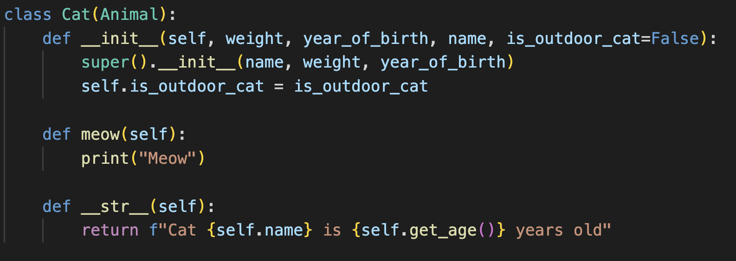
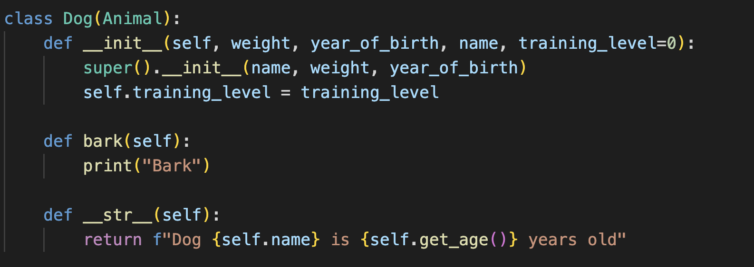
Inheritance (2/2)
# to create a subclass of a class, we use the following syntax
class SubClass(ParentClass):
def __init__(self, param1, param2):
super().__init__(param1) # super() calls parent class’ constructor – needed because overwritten __init__
self.param2 = param2

Slide 32
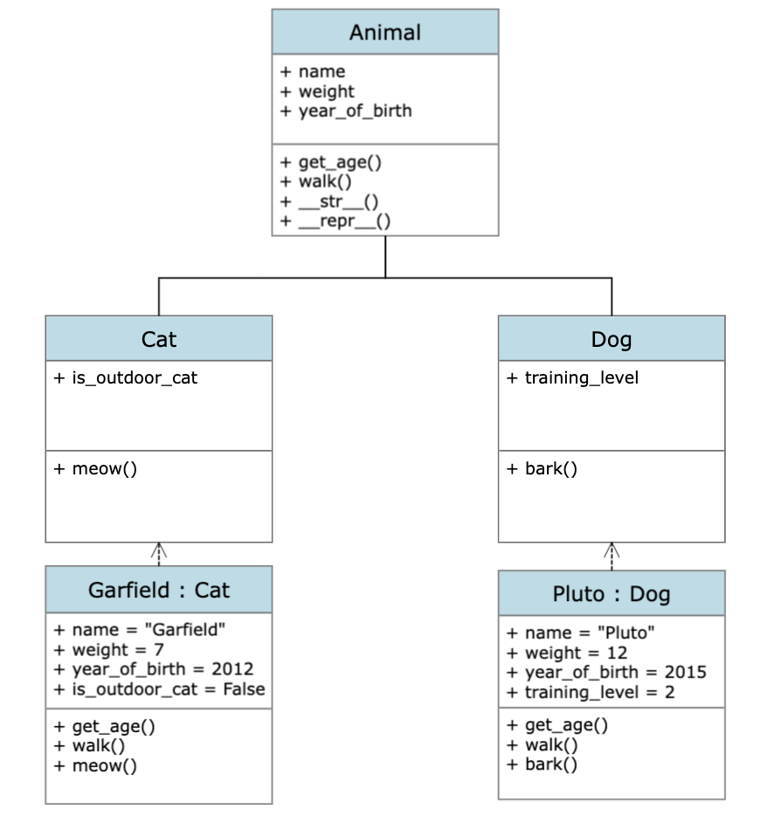
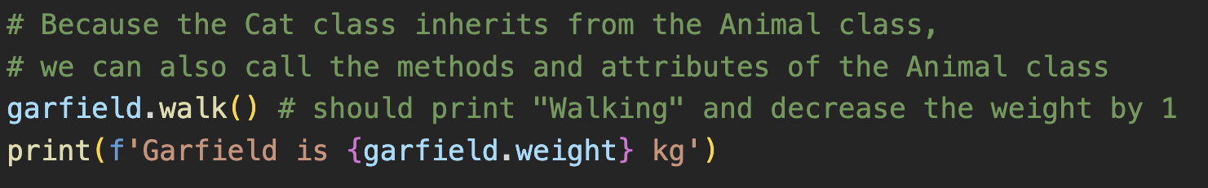
Polymorphism
Methods from the parent class, e.g., walk() can be executed on every object of the child classes Cat and Dog and will always work
Child classes can add specialized «behaviour» to extend the base classes functionality, the class cat could for example overwrite the walk method and specify that a cat looses less weight compared to a default Animal

Slide 33
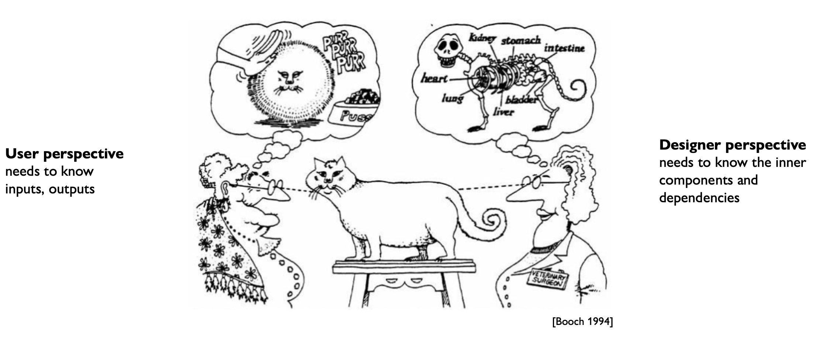
Encapsulation

Slide 34
oop
To read up

Slide 35
Exercise 5:
Let’s solve the exercise together…
…to enable you to solve the assignment on your own!

Slide 36
Excursus: Getter, Setter & @ Decorator

Slide 37
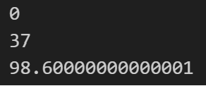
Access attributes directly
Code
class Celsius:
def __init__(self, temperature=0):
self.temperature = temperature
def to_fahrenheit(self):
return (self.temperature * 1.8) + 32
# Create a new object
human = Celsius()
print(human.temperature)
# Set the temperature
human.temperature = 37
# Get the temperature attribute
print(human.temperature)
# Get the to_fahrenheit method
print(human.to_fahrenheit())
Logic
We define a class with an object attribute
The object attribute can be manipulated by directly accessing it
Thus, there are no checks and no protection → This is not OOP
> “H”
> “!”
> “!”
> “H”
> “Hello”
> “World!”

Slide 38


Attribute Protection by Convention
Code
class Celsius_Protected:
def __init__(self, temperature=0):
self._temperature = temperature
human = Celsius_Protected()
print(human._temperature)
human._temperature = 37
print(human._temperature)
########################################################
class Celsius_Private:
def __init__(self, temperature=0):
self.__temperature = temperature
human = Celsius_Private() print(human._Celsius_Private__temperature)
human._Celsius_Private__temperature = 37
print(human._Celsius_Private__temperature)
# print(human.__temperature) # does not work anymore
human.__temperature = 80
print(human.__temperature)
Logic
In Celsius_Protected _temperature is only protected by convention (you should not access attributes with one _ from outside the class).
In Celsius_Private __temperature is protected more strongly:
You can not access it directly with human.__temperature from outside the class (workaround!).
If you write human.__temperature = 80 from outside the class you have 2 different __temperature in the object. The latter is accessible with human.__temperature
> “H”
> “!”
> “!”
> “H”
> “Hello”
> “World!”

Slide 39
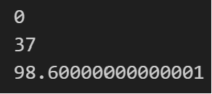
Getters & Setters
Code
class Celsius:
def __init__(self, temperature=0):
self.set_temperature(temperature)
def to_fahrenheit(self):
return (self.get_temperature() * 1.8) + 32
def get_temperature(self):
return self._temperature
def set_temperature(self, value):
if value < -273.15:
raise ValueError(“T < -273.15 not possible")
self._temperature = value
human = Celsius()
print(human.get_temperature())
human.set_temperature(37) # try constraint with -300
print(human.get_temperature()) print(human.to_fahrenheit())
Logic
We define a class that uses a setter to set the object attribute
The object attribute can be manipulated by using the setter and the getter
Thus, we can include checks and protection (note: as seen before, there is no real protection, as programmer you should just stick to the _-convention) → This is OOP → Can we do better?
> “H”
> “!”
> “!”
> “H”
> “Hello”
> “World!”

Slide 40
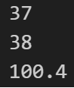
Using @ Decorator
Code
class Celsius:
def __init__(self, temperature=0):
self.temperature = temperature
def to_fahrenheit(self):
return (self.temperature * 1.8) + 32
@property
def temperature(self):
return self._temperature
@temperature.setter
def temperature(self, value):
if value < -273.15:
raise ValueError(“T < -273.15 not possible")
self._temperature = value
human = Celsius(37)
print(human.temperature)
human.temperature = 38
print(human.temperature)
print(human.to_fahrenheit())
Logic
We define a class that uses the @setter to set the object attribute.
The object attribute can be manipulated by using both @ methods. Python knows which one to use because the getter has no attribute [except self]) → When self.temperature (or equivalently human.temperature) is called [no () at the end; function=value is also a call], Python checks if it is called with =value or not. Note: Be careful about the difference of .temperature & ._temperature
> “H”
> “!”
> “!”
> “H”
> “Hello”
> “World!”

Slide 41
Now you have everything you need to start with assignment 5

